Slide 1
CSE 331
Automata and computability
NFAs
Summer 2026

Slide 2
Today's learning goals Sipser Ch 1.1, 1.2
Distinguish between an NFA and a DFA
Define nondeterminism and why it may be helpful
Design NFA recognizing a given language
Precisely specify general constructions for NFA recognizing languages output by operations

Slide 3
General proof structure/strategy
Theorem: For any L over Σ, if L is regular then [ the result of some operation on L ] is also regular.
Proof:
Given name variables for sets, machines assumed to exist.
WTS state goal and outline plan.
Construction using objects previously defined + new tools working towards goal. Give formal definition and explain.
Correctness prove that construction works.
Conclusion recap what you've proved.

Slide 4
Regular languages
Over any fixed alphabet,
Each finite language is regular
There are infinite regular languages
If a set is regular, its complement is also regular
If two sets are regular, their union is also regular
If two sets are regular, their intersection is also regular

Slide 5
The regular operations Sipser Def 1.23 p. 44
For A, B languages over same alphabet, define:
✔
How can we prove that the concatenation of two regular languages is a regular language?

Slide 6
Construction
How would this work for A = { a^{n} | n ≥ 0 }, B = {b^{m} | m ≥ 0 }?
Input
M2
M1

Slide 7
Solution: nondeterminism
Allow transitions that don't "consume" any input
Instead of exactly one outgoing transition from each state labelled by each symbol
  Can have 0 transitions
  Can have > 1 transitions

Slide 8
Construction
How would this work for A = { a^{n} | n ≥ 0 }, B = {b^{m} | m ≥ 0 }?
ε
Input
M2
M1
ε

Slide 9
New – easier – construction for union
"Guess" one of finite list of criteria to meet
Accept if
either (or both) accepts
M1
Input
M2

Slide 10
Caveat
This nondeterminism trick doesn't help us with closure arguments.
Why?
To prove that the class of regular languages is closed under OP, needs that OP(L) is recognized by a DFA

Slide 11
Caveat
This nondeterminism trick doesn't help us with closure arguments YET!
Why?
We'll prove that any language recognized by some NFA is also recognized by some (different) DFA.

Slide 12
Differences between NFA and DFA
DFA: unique computation path for each input
NFA: allow several (or zero) alternative computations on same input
  δ(q,x) may specify more than one possible next states
  ε transitions allow the machine to transition between states spontaneously, without consuming any input symbols

Slide 13
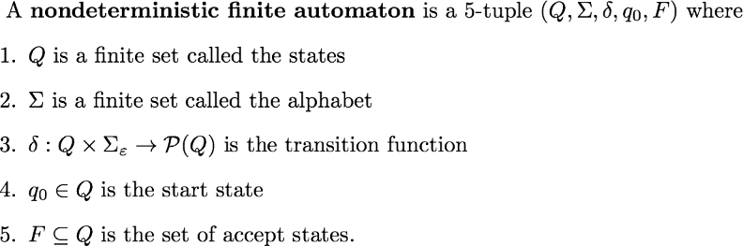
Formal definition of NFA

Slide 14
Formal definition of NFA
Which piece of the definition of NFA means there might be more than one possible next state from a given state, when reading symbol x from the alphabet?
Line 2, the size of Σ
Line 3, the domain of δ
Line 3, the codomain of δ
Line 5, that F is a set
I don't know.

Slide 15
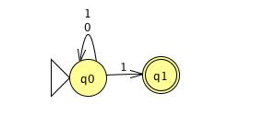
Tracing NFA execution
Is 0 accepted?
Is 1 accepted?
Is 0101 accepted?
Is 110 accepted?
Is the empty string accepted?

Slide 16
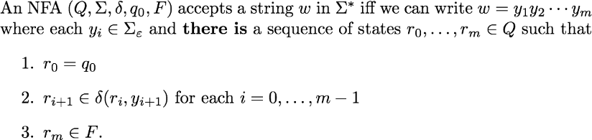
Acceptance in an NFA

Slide 17
More differences between NFA and DFA
DFA: unique computation path for each input
NFA: allow several (or zero) alternative computations on same input
  δ(q,x) may specify more than one possible next states
  ε transitions allow the machine to transition between states spontaneously, without consuming any input symbols
Types of components of formal definition
  DFA
  NFA

Slide 18
Similarities between DFA and NFA
If L is a language recognized by a DFA, is there some NFA that recognizes it?
  Yes
  No
  Depends on L
  I don't know.

Slide 19
Next steps
Defining NFA in closure constructions formally.
Showing that NFA and DFA are equally expressive

Slide 20
Concatenation
"Guess" some stage of input at which switch modes
Given DFAs M1 = (Q1,Σ,δ1,q1,F1), M2 = (Q2,Σ,δ2,q2,F2)
build NFA N = (Q1 U Q2, Σ, δ, q1, F2) with δ…
Input
M2
M1

Slide 21
Concatenation
δ( q, x ) = if q is in Q1, x is in Σ
if q is in Q2, x is in Σ
?
Input
M2
M1

Slide 22
Concatenation
δ( q, x ) = {δ1(q, x)} if q is in Q1, x is in Σ
{δ2(q, x)} if q is in Q2, x is in Σ
Input
M2
M1

Slide 23
Concatenation
δ( q, x ) = {δ1(q, x)} if q is in Q1, x is in Σ
{δ2(q, x)} if q is in Q2, x is in Σ
{q2} if q is in F1, x = ε
otherwise
Correctness proof in the book (page 61)
Input
M2
M1

Slide 24
Star operation
ε
Input
ε
M
Given M1 = (Q1,Σ,δ1,q1,F1), build
N = ( Q1 U {q0}, Σ, δ, q0, F1 U {q0} )
and δ(q,x) = …
Construction in the book (page 63)
ε

Slide 25
Next steps
Showing that NFA and DFA are equally expressive.

